Slide 1
Clustering Methods
for Three Phase Power Recognition
Project Demonstration
Name: Kaige Zhang
Supervisor: Richard Bean

Slide 2
Table of Content
Background
Goal
Methodology
Experiment Result
Conclusion

Slide 3
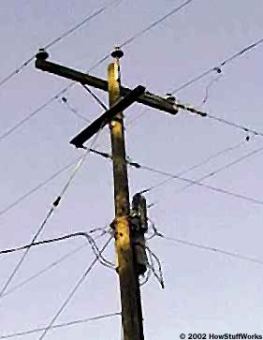
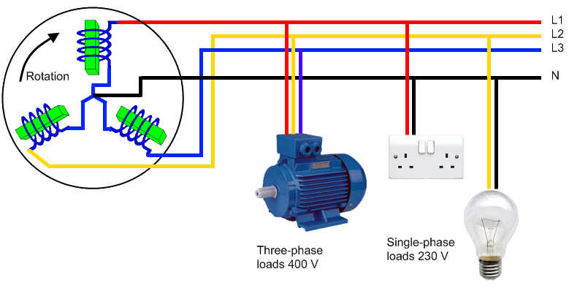
Background
Three-phase electric power
It is a type of polyphase system and it is used in Queensland power grid.
There are three active wires and one neutral wire.
Each active wire provides one different phase power.
One household will link to one active wire which means use one phase power in three-phase.

Slide 4
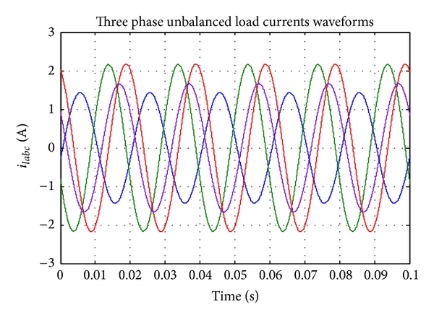
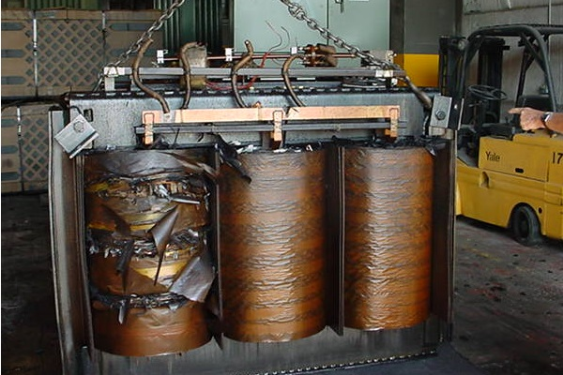
Background
Problem Identification
The different customer has different power consumption pattern, the pressure on the three phases of a transformer may constant to be imbalanced because of how the households are arranged to the different phases.
Problems caused by imbalanced load:
The power loss is greater than for a perfectly balanced system.
Higher machine stress causes earlier machine failure.

Slide 5
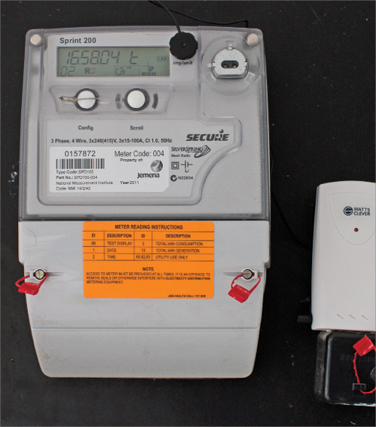
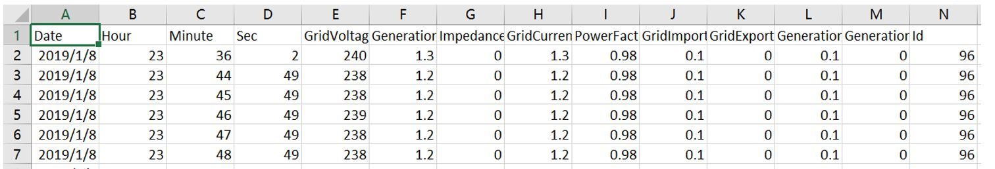

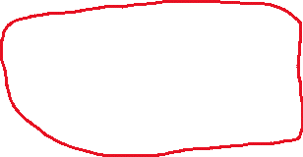
Background
Rebalance – Phase Identification
For balancing the pressure, the first step is to know which phase the household use.
Data collected from the smart meter makes it possible to apply the clustering algorithms to do phase identification of the household.
Data stored in Date, Hour, Minute, Sec, GridVoltage and Id columns are the main parameters used in this project.

Slide 6
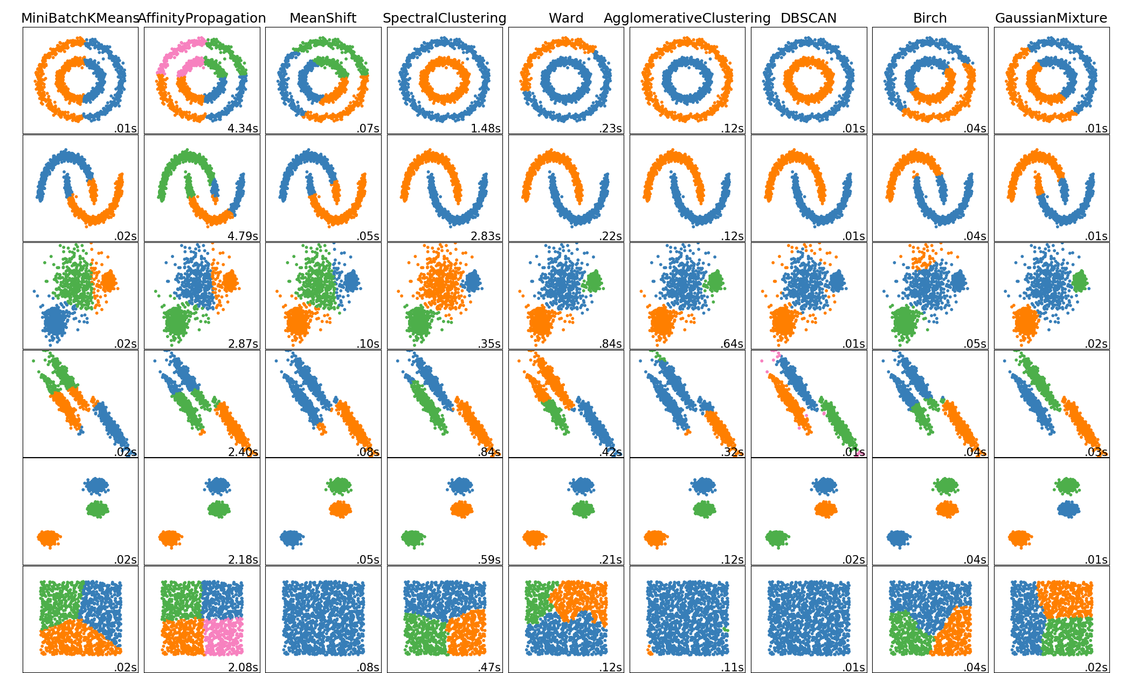
Goal
This project aims to test four different clustering algorithms with given data for phase identification and compare the performance of them to find which one has the best performance.
The selected clustering algorithms are: K-means, DBSCAN, Mean-shift and Gaussian.

Slide 7
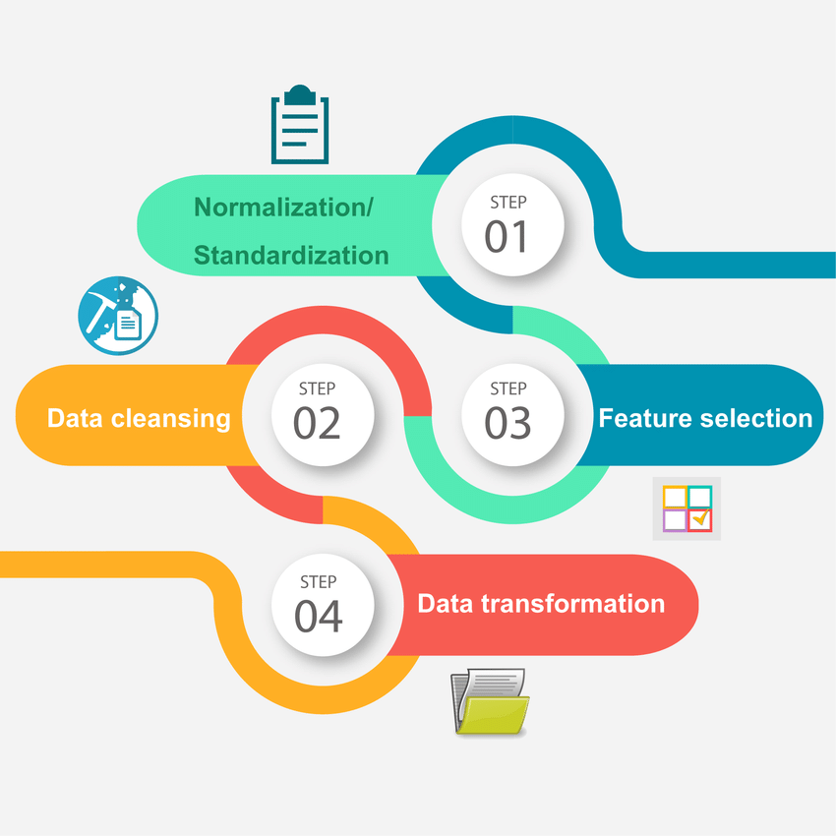
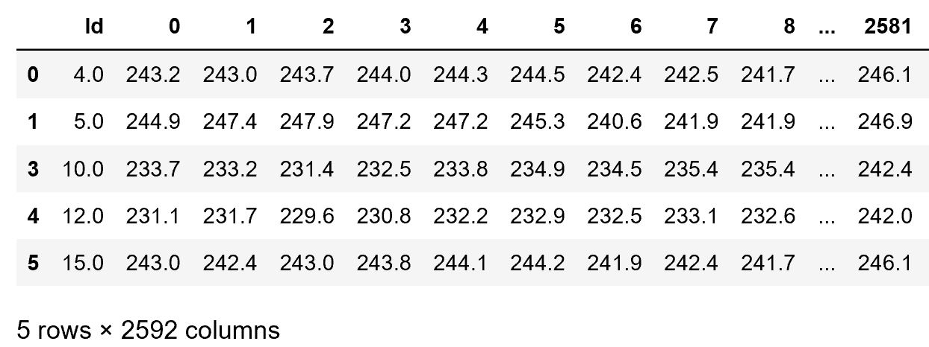

Methodology
Preprocessed dataset
Aggregate the dataset into different levels based on the Ids, Date, Minute and GridVoltage. For example, in Fig 1, average voltage at 10 minute slices within a month for each Id.
Chop all the values at one decimal place.
Other aggregate levels, for example:
Average voltage at 10 minute slices within a day for each Id.
Hourly average voltage within a month for each Id.
…
Household Identification
Average voltage data ordered by time sequence – 10-minute slices
Fig 1

Slide 8

Methodology
Preprocessed dataset - Integrity
Problems when preprocess the data
Data Integrity
The records within some time slices are not exist.
E.g. Records of GridVotage for Id 54 between 20:10:00 and 20:20:00 on 10/02/2019 are not exist.
Ids Without ground truth
Some Ids in the dataset do not have the ground truth makes it impossible to calculate the accuracy after clustering.
Solution
Preprocess the dataset to find the period of dataset with good integrity.
If an Id is missing a record in a certain time slices, delete the records of all the Ids in that time slices. No fake data like median voltage to fill in the missing slices.
Drop the Ids which do not have the ground truth, and all its records. (Invalid Id)

Slide 9
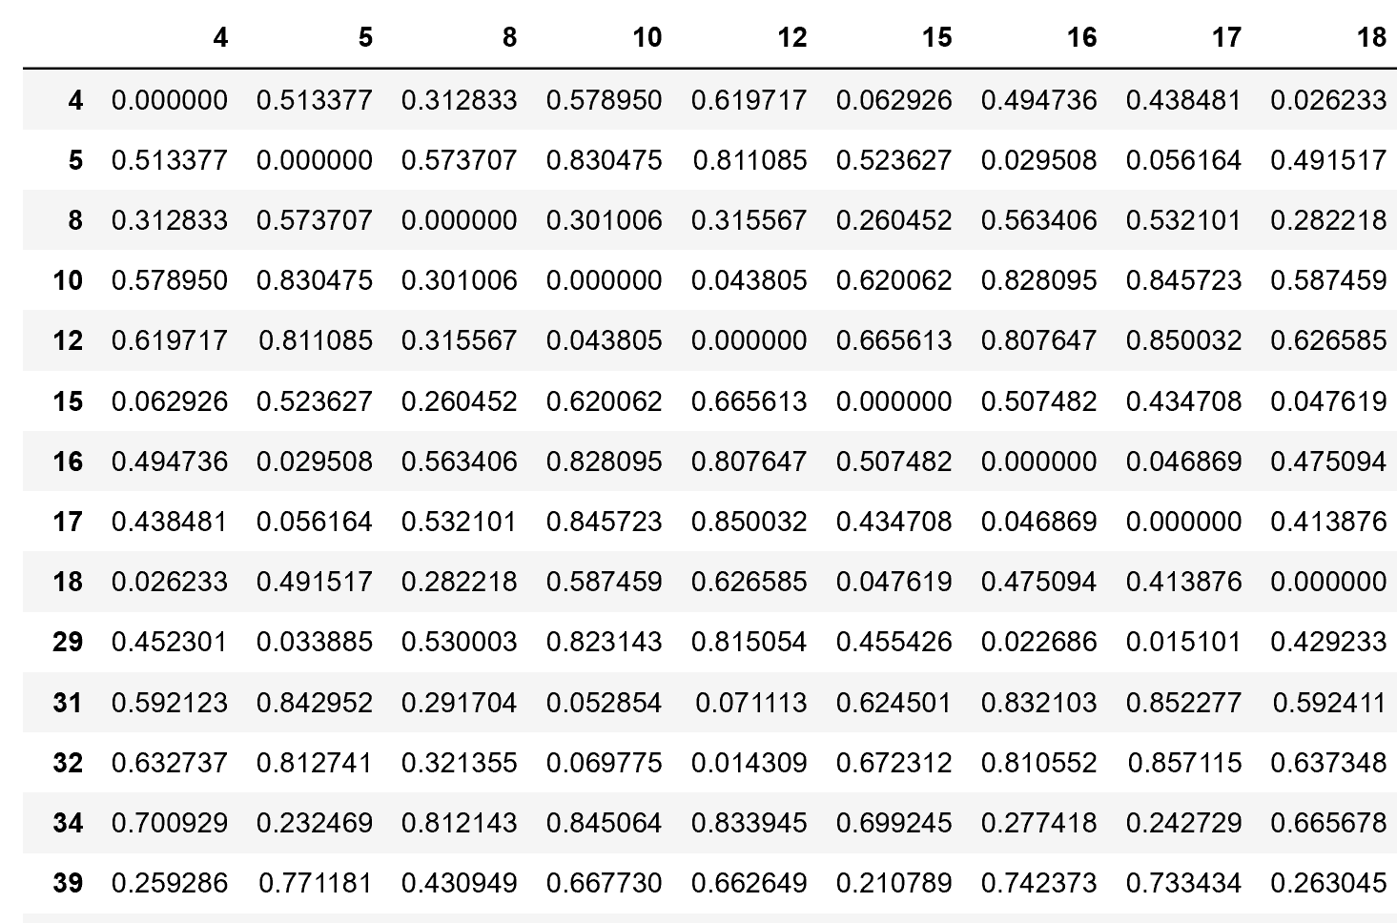
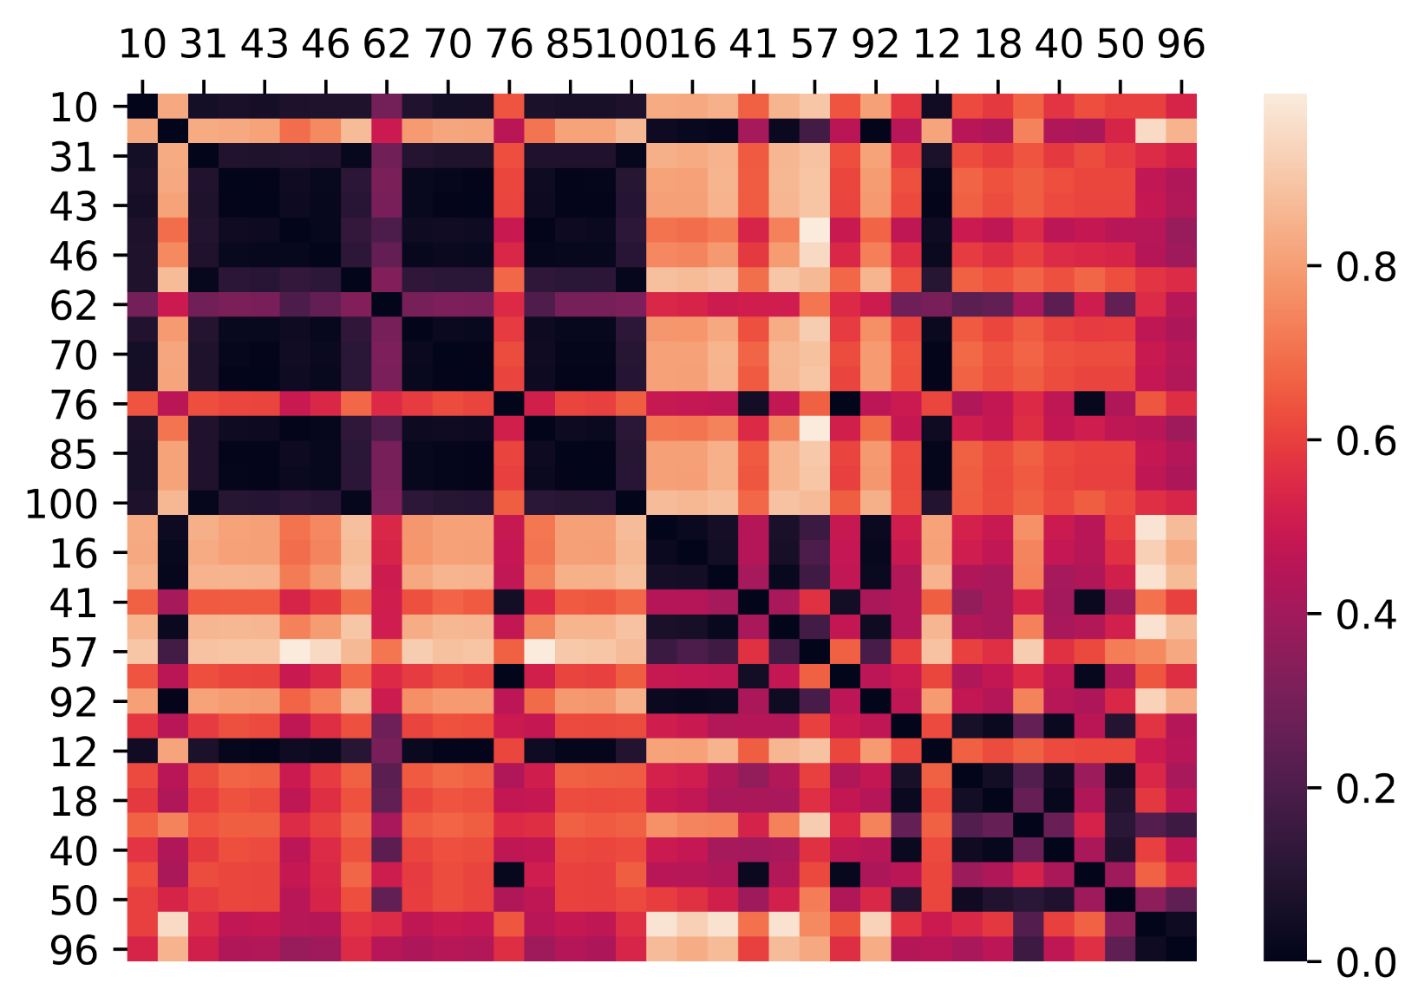
Methodology
Correlation coefficient/Dissimilarity matrix
Correlation coefficient
Pezeshki and Wolfs found a correlation-based method for phase identification in a three-phase power distribution network in the past experiment and it has good performance.
In this project, the correlation coefficient between every Ids’ records will be calculated.
Preprocessed Dataset(For calculating correlation coefficient)
Dissimilarity Matrix
The correlation coefficient between every Ids’ records will be used to generate dissimilarity matrix for the input of the clustering algorithms.
Dissimilarity Matrix
X, Y = Ids
Heatmap of dissimilarity matrix ordered by the ground truth.

Slide 10
Experiment Result
Performance of four clustering algorithm
Two datasets named as t1 and t2, both have 35 valid Ids for households.
The chart shows the accuracy of the result of running the algorithm on both datasets with 10-minute slices data from February, by comparing to the ground truth.
10-minute data within February has good integrity for both datasets.
10-minute data within a month is large enough to have the convincing result.
It can be observed that the Gaussian Mixture clustering algorithm has the highest accuracy on both data files.
The same result for other aggregate levels of datasets. Sometimes, K-means has the same accuracy as Gaussian but never higher than Gaussian.

Slide 11
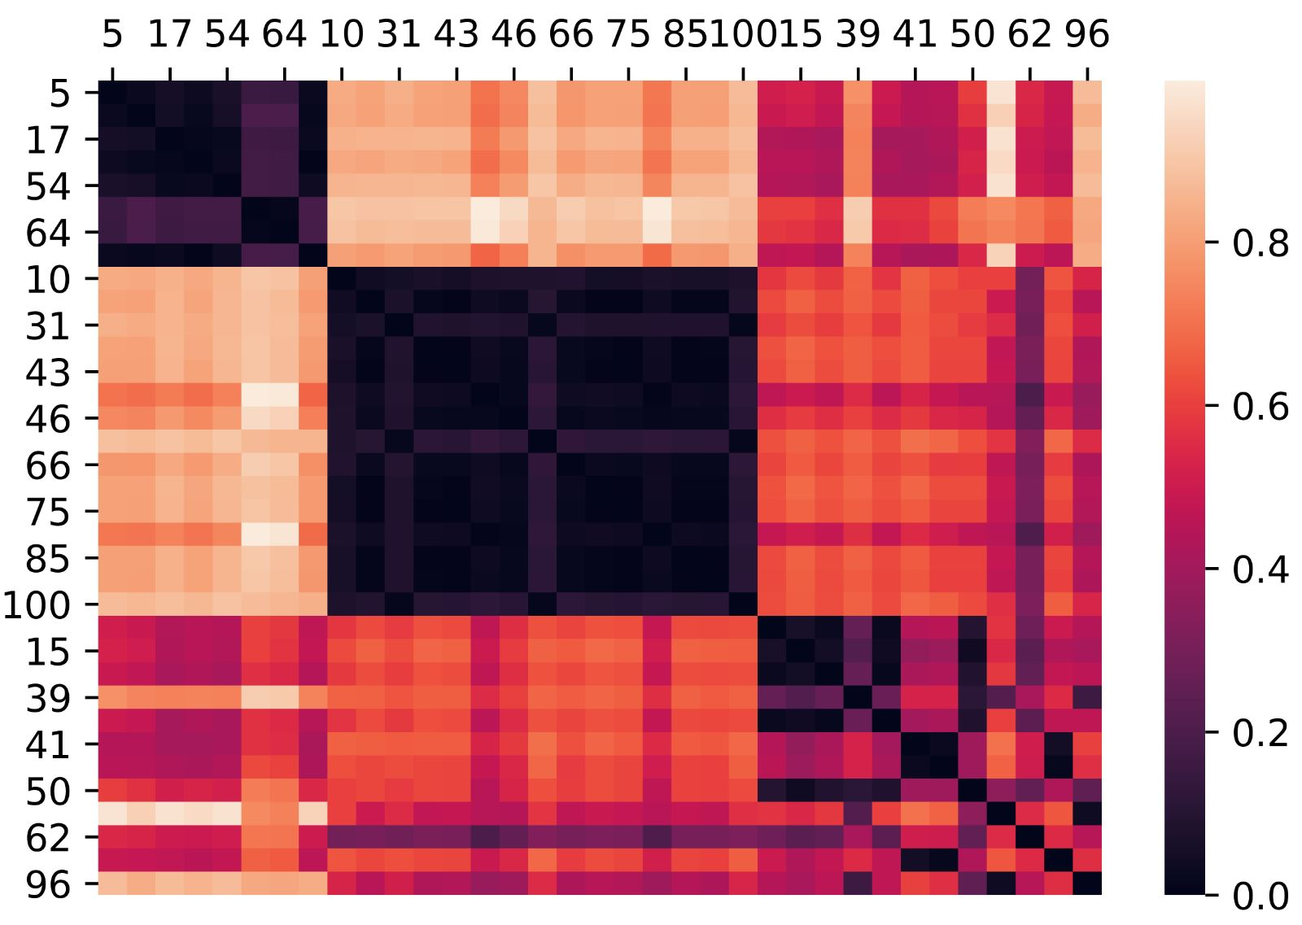
Experiment Result
Heatmap – Gaussian Clustering
Comparing the heatmap of the dissimilarity matrix with reordered Ids by the result of Gaussian Clustering to the heatmap of the dissimilarity matrix with ordered Ids by the ground truth.
It can be observed that
There are three clusters in the heatmap.
Different clusters are clustered based on the value of dissimilarity.
Some differences between the heatmap of the ground truth and the Gaussian clustering result.
Heatmap of dissimilarity matrix ordered by the ground truth.
Reordered the heatmap of dissimilarity matrix by the result of clustering

Slide 12
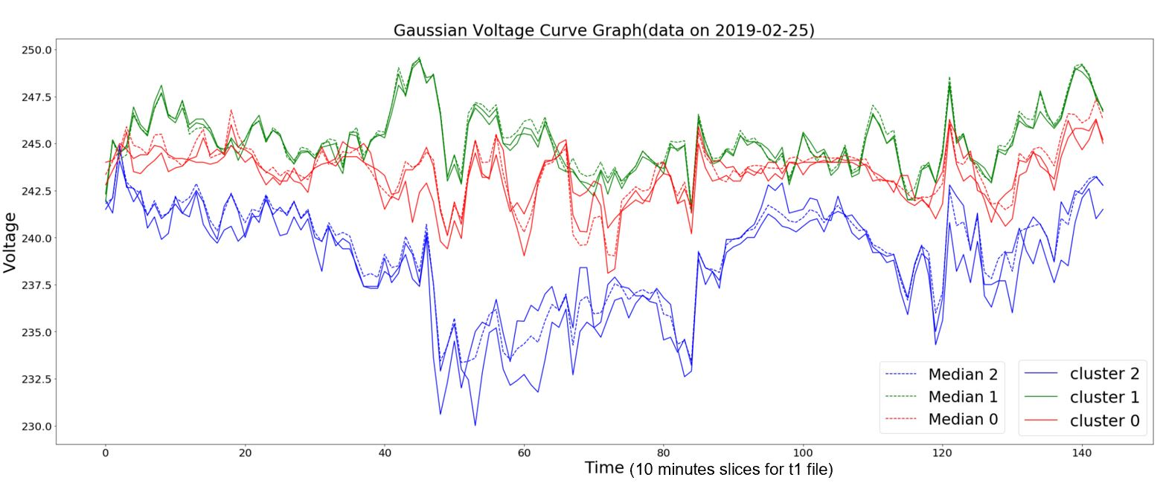
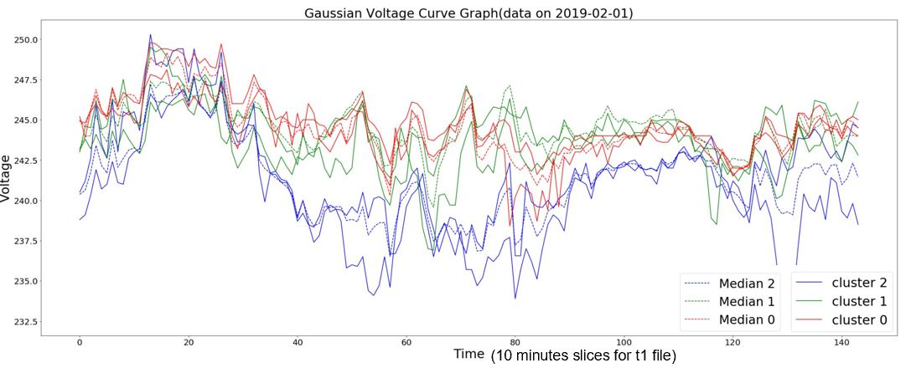
Experiment Result
Phase Recognition Visualization – Gaussian Clustering
Phase recognition visualization on different days for different files.
Each solid line represents one different Id and each color represents one different phase.
Each dot line represents the median of one different phase.
It can be observed that two Ids within a recognized phase have the same line pattern.
It can be observed that three phases have different line patterns with each other just like what happens in the real word.
Phase recognition visualization for t1 dataset
Phase recognition visualization for t2 dataset

Slide 13
Conclusion
The Gaussian Mixture clustering algorithm has the best performance using a dissimilarity matrix generated by correlation coefficient as the input for three phase power recognition of households by comparing to other three clustering algorithms include K-means, DBSCAN, Mean-shift.

Slide 14
THANK YOU

Slide 15
Q&A

Slide 16
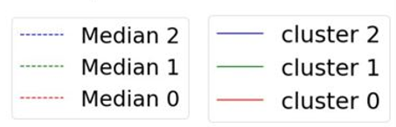

Slide 17
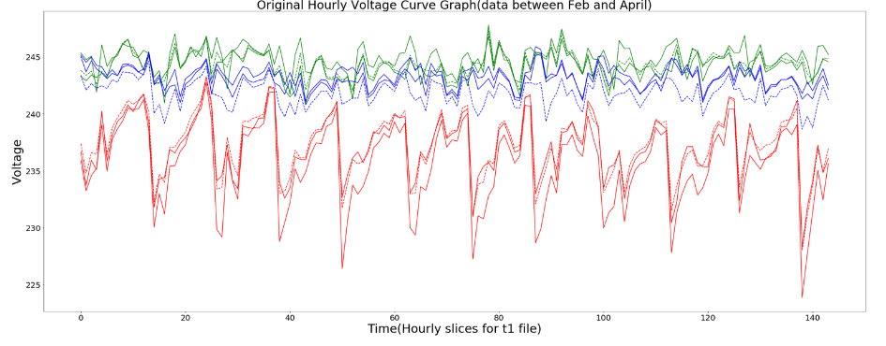

Slide 18
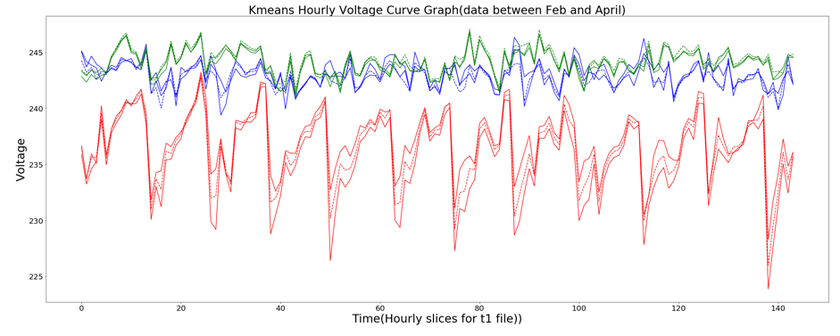

Slide 19
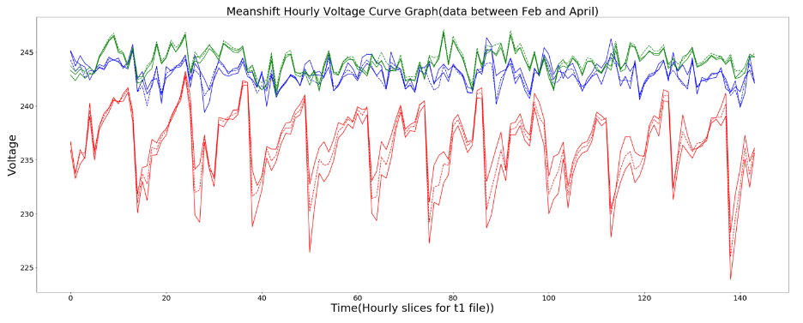

Slide 20
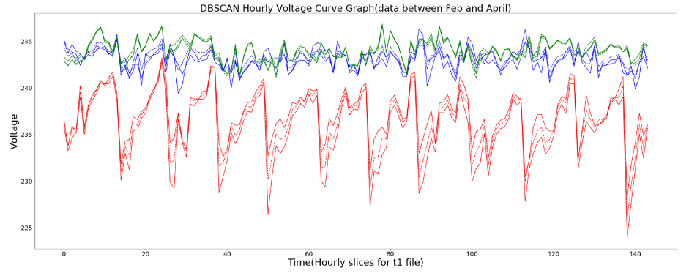

Slide 23
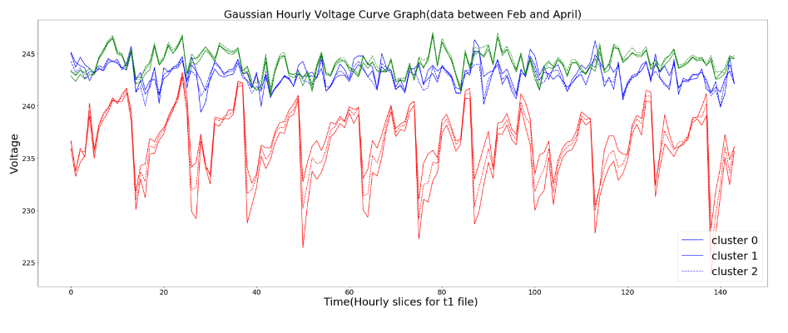

Slide 24
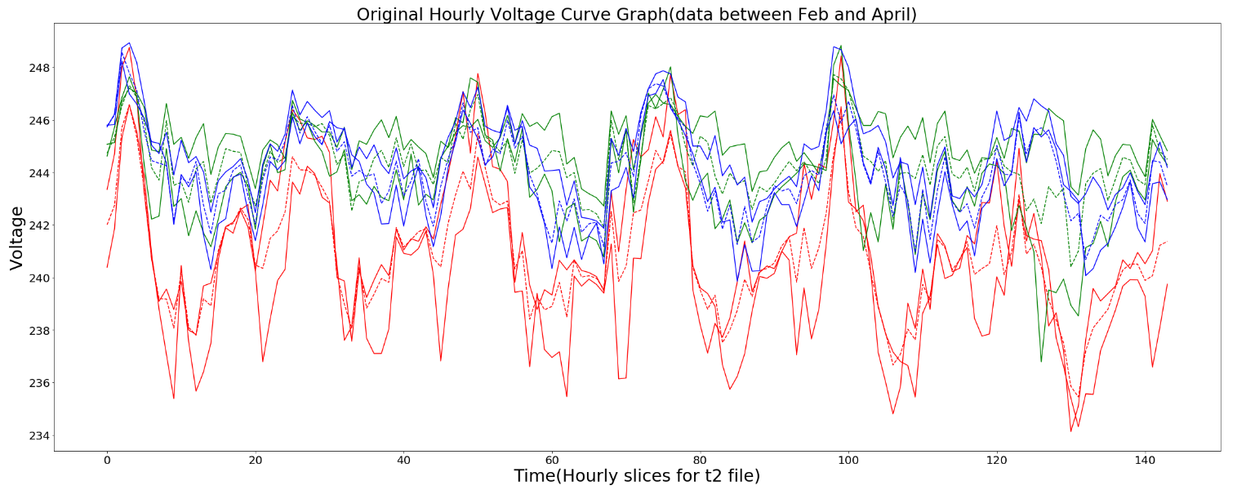

Slide 25
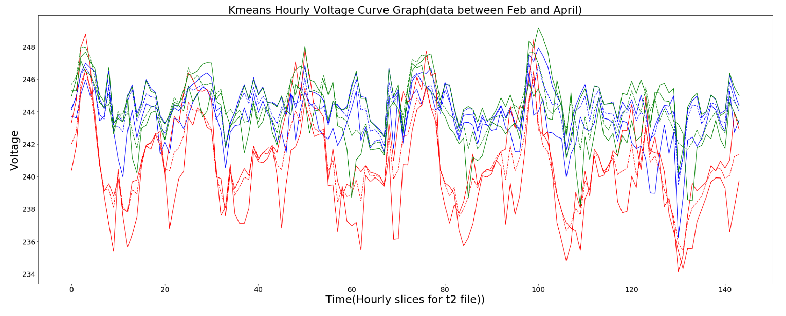

Slide 26
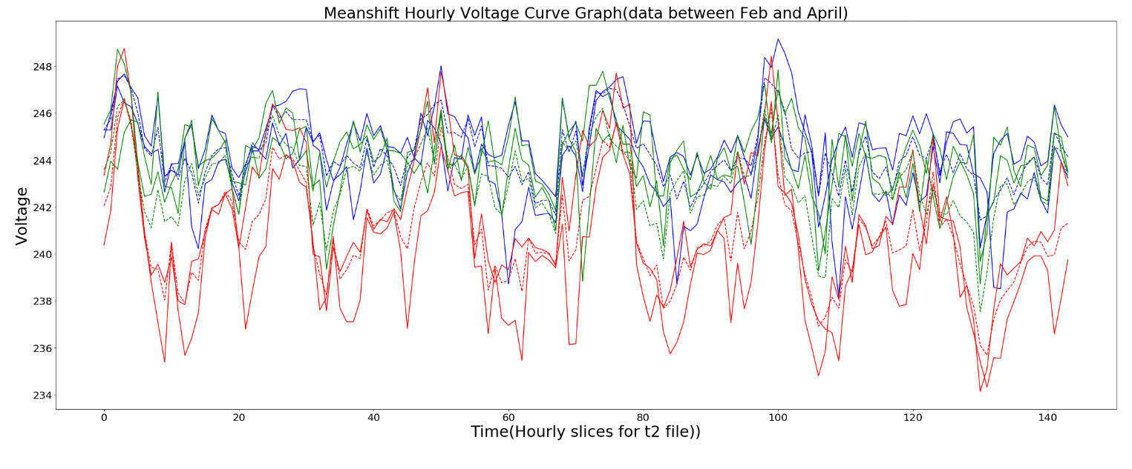

Slide 27
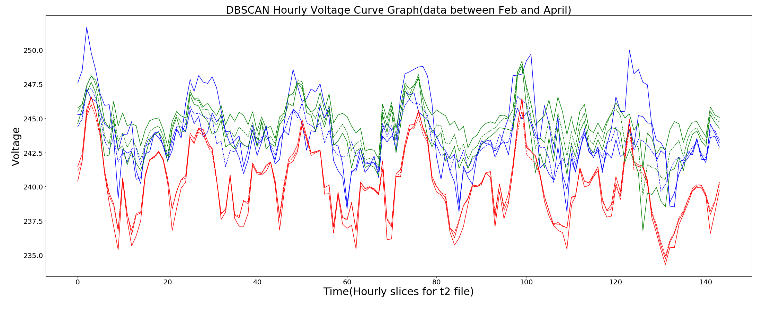

Slide 28
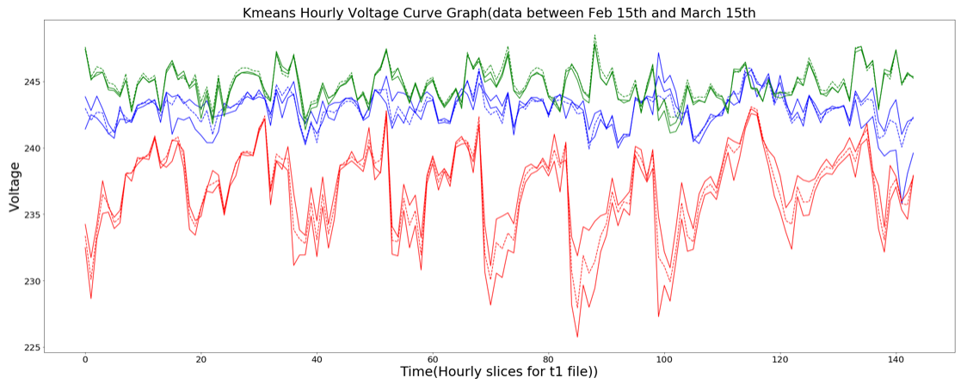

Slide 29
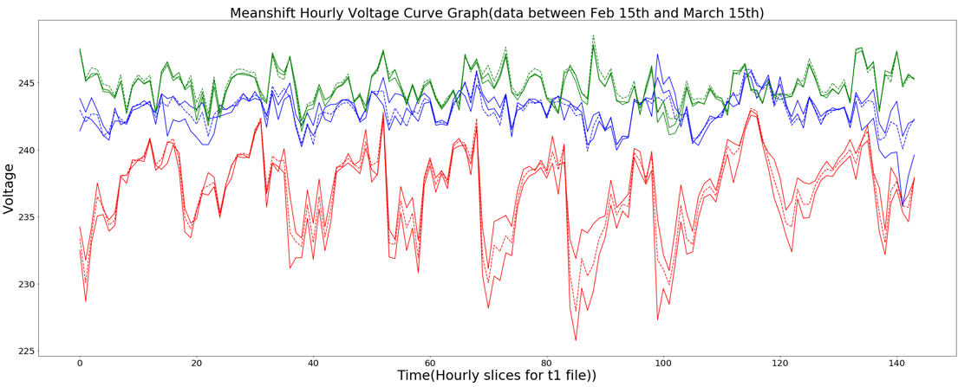

Slide 30
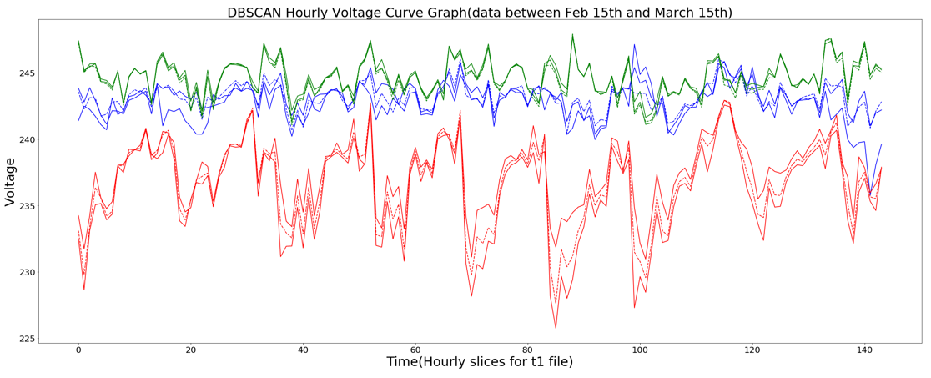

Slide 31
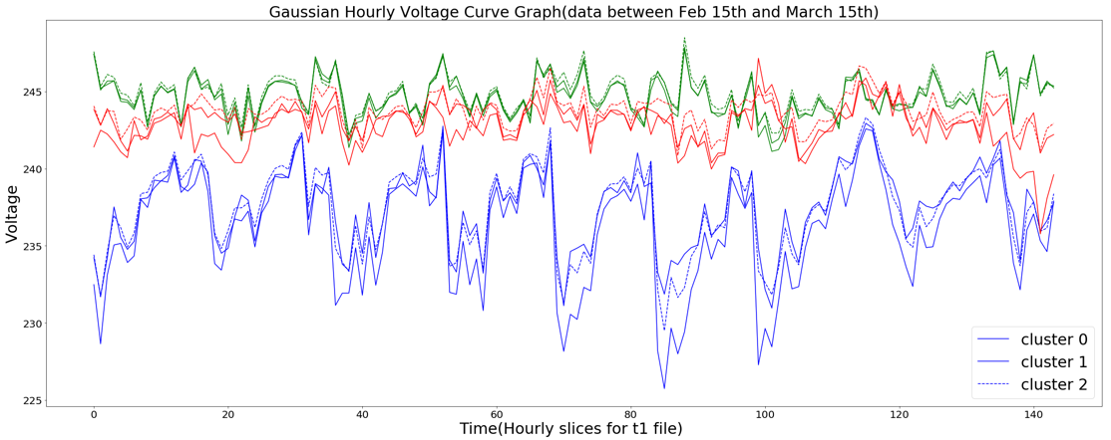

Slide 32
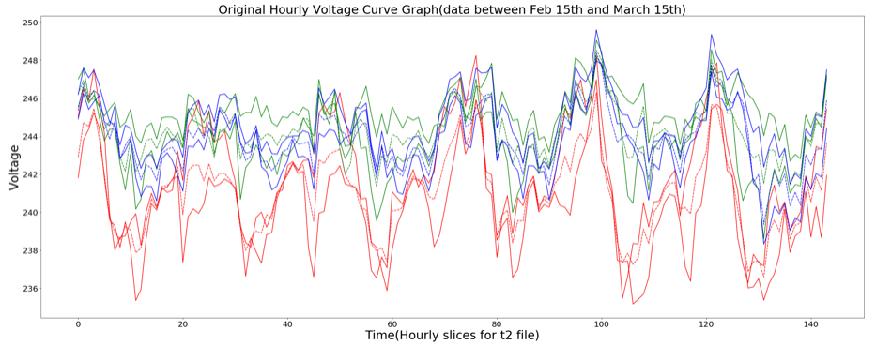

Slide 33
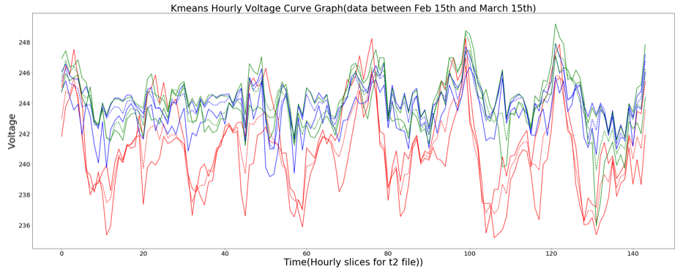

Slide 34
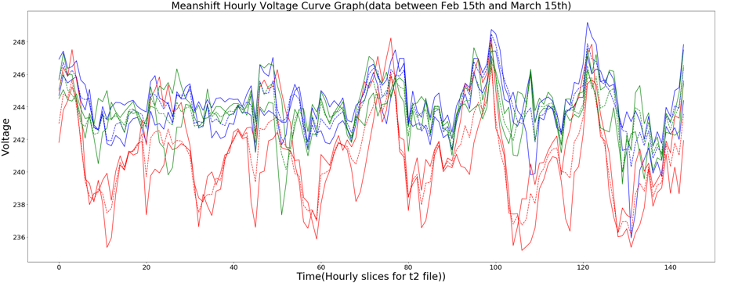

Slide 35
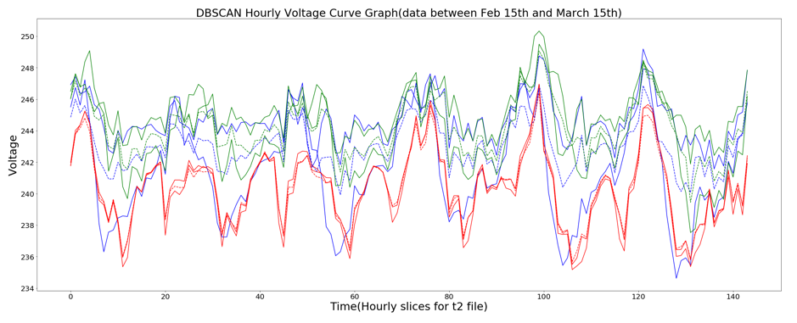

Slide 36
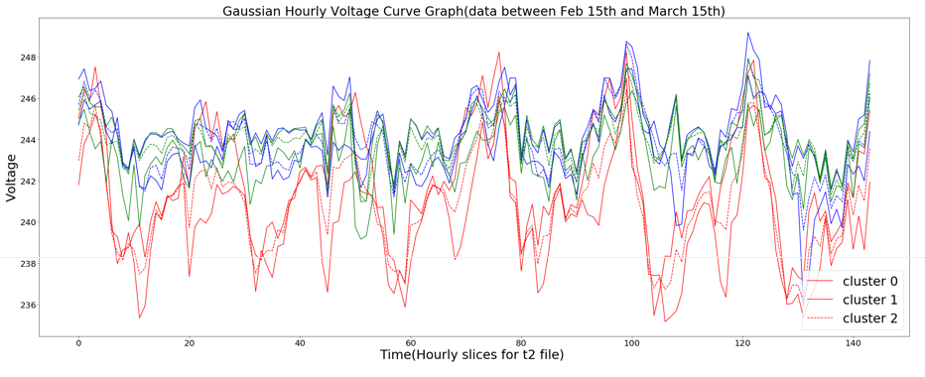

Slide 37
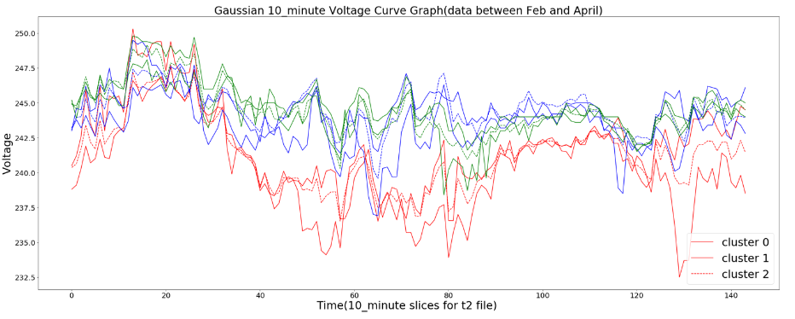

Slide 38
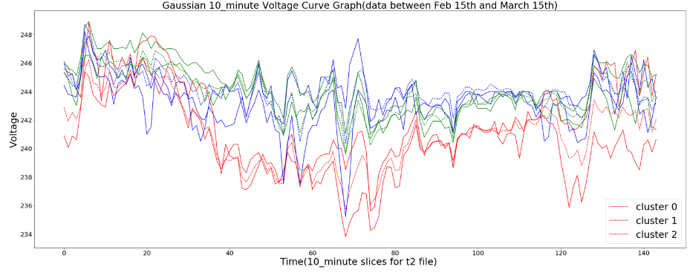

Slide 39
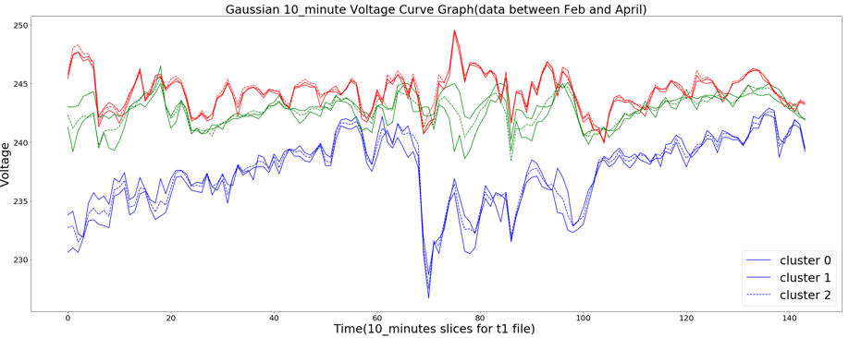

Slide 40
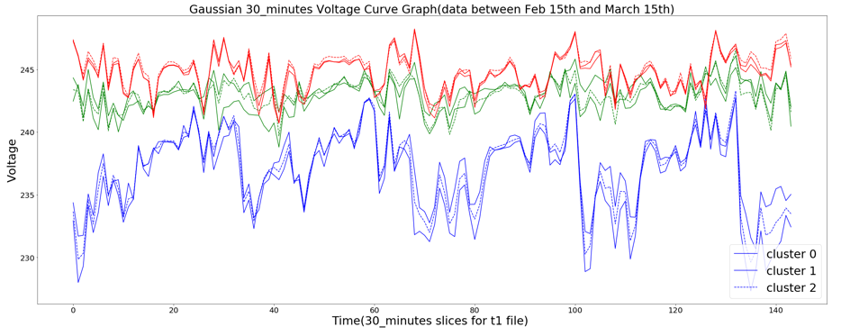

Slide 41
